Slide 1
Classification of Breast Metastasis Whole-Slide Images for CAMELYON 17 Challenge
Dong Liang, Li Ai, Shuang Zhou

Slide 2
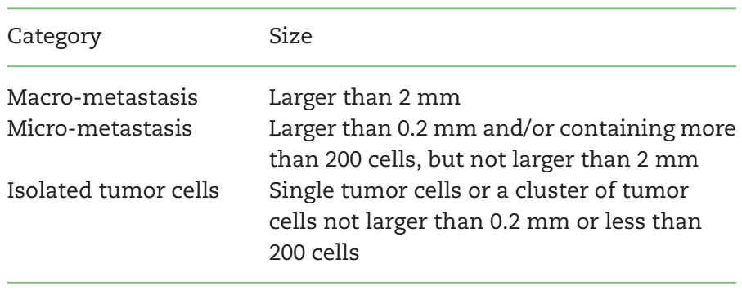
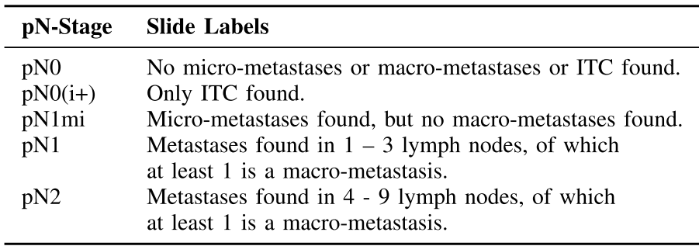
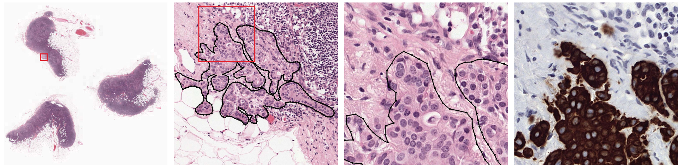
Overview of Projects
Table 1. WSI-level metastasis categories
Table 2. Patient-level pN-stages used in the challenge. Each patient is supplied with 5 WSIs.
Figure 1. Example of a WSI with micro-metastasis at increasing zoom levels. The metastasis is outlined with black.

Slide 3
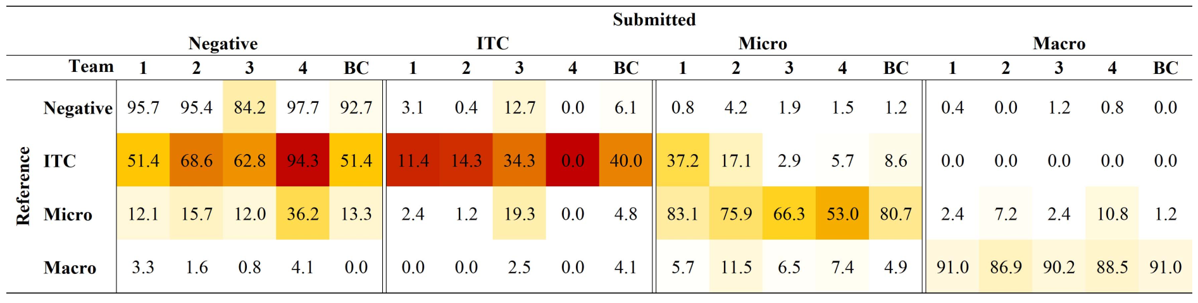
Our Task
Table 3. WSI-level confusion matrices of the best four teams with the accuracy in percentages. BC is the best combination of algorithms.
Because of the constraint of resources, in our project, we will be trying to only classify negative and ITC samples, as the majority of ITC samples were classified as negative even by the best performing teams.

Slide 4
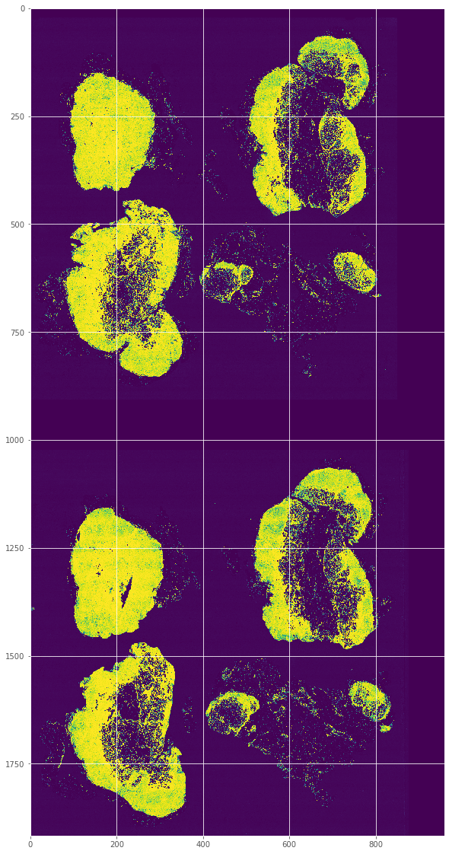
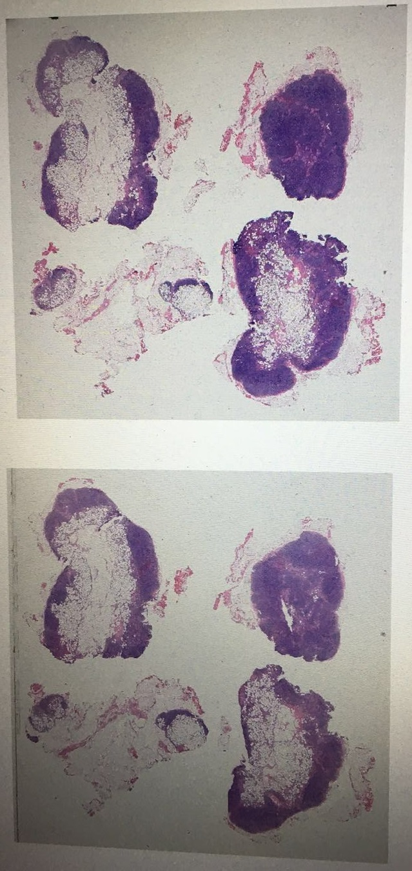
Two-Step Approach
96x96
1x1
Negative
Step-2 model
Step-1 model
time-consuming: takes ~36 hrs to finish one WSI
ITC
~20Kx10K
2000x1000

Slide 5
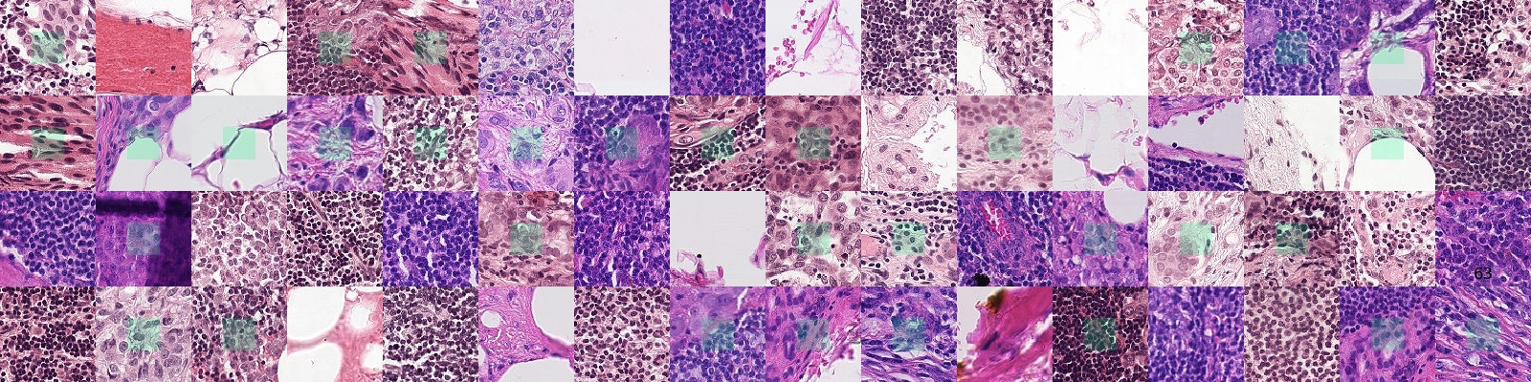
Step-1 Data
Figure 2. Examples of 96x96 patches extracted from original C16 WSIs. from https://github.com/basveeling/pcam.

Slide 6
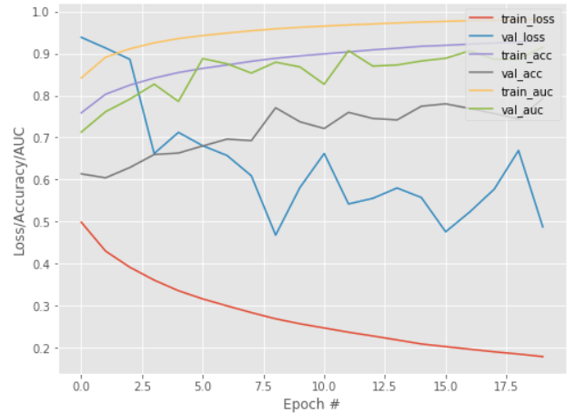
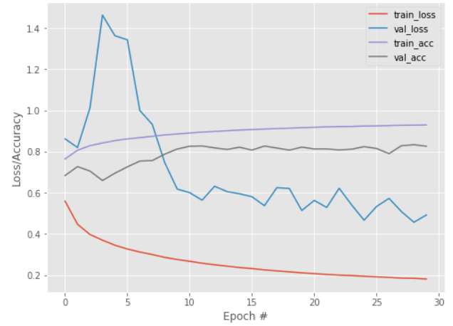
Training History of Baseline CNNs from Step-1
(a)
(b)
Figure 1. Loss, accuracy and AUC for (a) ResNet50 and (b) small VGGNet (both trained from scratch).
(will provide the training history of InceptionV3 model later)

Slide 7
Step-1 Result Summary
CNN Architecture | Loss |  |  | Accuracy |  |  | AUC
 | Train | Valid | Test | Train | Valid | Test | Train | Valid | Test
small VGGNet | 0.181 | 0.492 | 0.938 | 0.929 | 0.826 | 0.724 | / | / | /
ResNet50 | 0.179 | 0.487 | / | 0.930 | 0.793 | / | 0.982 | 0.915 | /
InceptionV3 | / | / | 0.510 | / | / | 0.807 | / | / | 0.934
Among the 3 CNN architectures (small VGGNet, ResNet50 and InceptionV3), InceptionV3 performs the best and is thus chosen as the baseline model for refinement.
(will try to provide missing stats for the final report depending on time constraints).

Slide 8
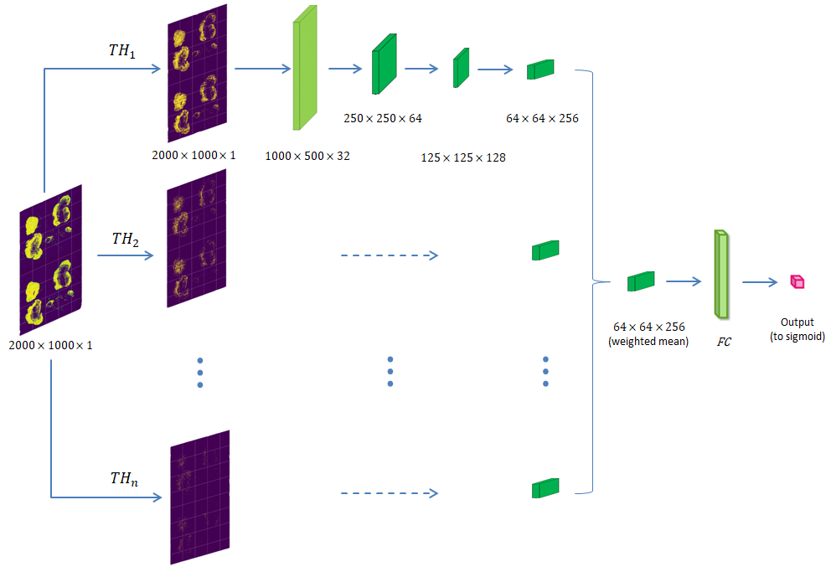
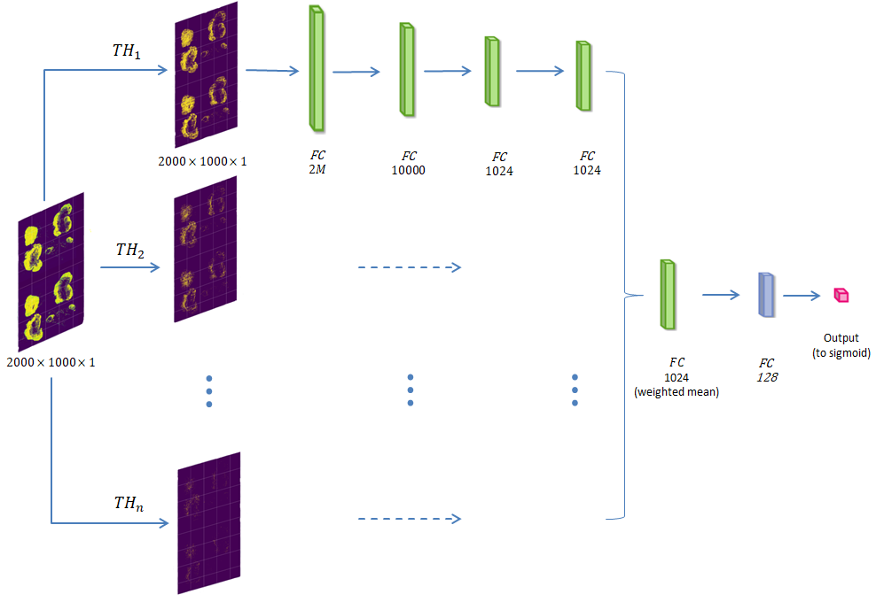
Architecture of Step-2 Models
(a)
(b)
Figure xx. Architecture of Step-2 Models: (a) CNN and (b) fully-connected.

Slide 9
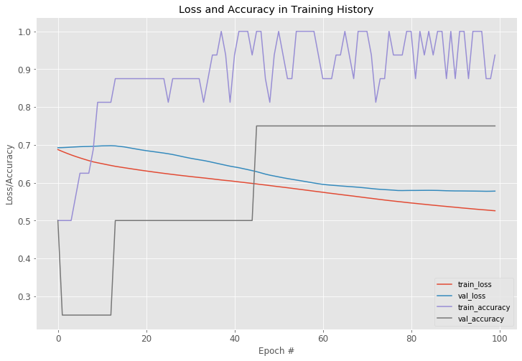
Step-2 Results
Figure xx. Training History of Step-2 MLP Model (20 samples).

Slide 10
Basic assumption: The quality of training results depends to a large extent on the composition of training samples. A good training process should take into account both consolidation and improvement.
Composition of training samples :
α % consolidation + (100 – α) % improvement; (0 < a < 100)
Hypothesis: In the final stage of training when the model has learned most features and encountered a bottleneck in the accuracy rate, dynamic training can strengthen the model by exposing it to more new error-prone samples.
Key point: Find two groups of latent embeddings corresponding to the correctly labeled and mislabeled samples, and distinguish them as much as possible in the latent space.
Implementation: Siamese neural network version, Autoencoder version
Targeted Dynamic training

Slide 11
TARGETED DYNAMIC TRAINING
1. Randomly sample 1 % of test dataset → samplar; the remaining 99 % of test dataset → new test dataset
2. Partition the samplar into two cohorts of mislabeled and correctly labeled samples based on the model prediction.
3. Calculate the per-sample probability of being mislabeled for the valid dataset (error-prone).
4. Adjust the composition of the new training samples as follows:
α % random training samples + (1 – α) % error-prone valid samples, where 1 - α is proportional to test accuracy of the image classifier (or simply set a = 0)
5. Retrain the model with the new training samples. Calculate the test accuracy.
6. Repeat step 1- 5 until the test accuracy converges
Prototype of algorithm

Slide 12
Per-sample latent feature using autoencoder
Training
Latent embedding
1% Test samples
Misclassified
Misclassified
Correctly classified
Autoencoder
Correctly classified

Slide 13
Per-sample probability of being mislabeled
Prediction
Misclassified latent embedding
Cosine distance1s
Valid latent embedding
Autoencoder
XX.XX % of being misclassified
Valid Sample
Correctly classified latent embedding
Cosine distance2s
Per-sample prob = $\frac{\text{1/}\text{m}\text{in}\text{(}\text{cosine}\text{_}\text{distance}\text{1(}\text{x}\text{))}}{\text{1/}\text{min}\text{(}\text{cosine}\text{_}\text{d}\text{istance}\text{1(}\text{x}\text{))+ 1/}\text{min}\text{(}\text{cosine}\text{_}\text{d}\text{istance}\text{2(}\text{x}\text{))}}$

Slide 14
Per-sample similarity score using Siamese neural network
Training
Latent embedding
1% Test samples
Negative pairs
CNN
Sigmoid activation
Similarity score
Abs (h1 – h2)
Positive pairs
CNN

Slide 15
Per-sample probability of being mislabeled
Prediction
Mislabeled cohort
Similarity score1s
Siamese
Valid Sample
XX.XX % of being
mislabeled
Correctly labeled cohort
Siamese
Similarity score2s
Per-sample prob = $\frac{\text{E}\text{x}\text{\sim }\text{cohort}\text{1[}\text{Similarity} \text{score}\text{1(}\text{x}\text{)]}}{\text{E}\text{x}\text{\sim }\text{cohort}\text{1[}\text{Similarity} \text{score}\text{1(}\text{x}\text{)] +}\text{E}\text{x}\text{\sim }\text{cohort}\text{2}\text{[}\text{Similarity} \text{score}\text{2(}\text{x}\text{)] }}$

Slide 16
A
Latent dimensions
B
Random samples
Autoencoder-generated latent features for correctly- (A) and mis- (B) classified images
with sample images shown side by side on the right

Slide 17
A
B
(A) Distribution of predicted misclassification probabilities. (B) True misclassification rate of the three groups of training samples

Slide 18
Training loss

